Slide 1
FE Project #5
PowerPoint Report
Josh Bevan
UMass Lowell
22.311 202 - Spring 2012

Slide 2
Objectives
Chief objective was to investigate stress concentrations in an axially-loaded long thin steel plate with a circular hole
Accomplished in three parts:
Use FEA methods to model stress concentrations
Use empirically derived data obtained from photoelastic method to estimate stress concentration
Compare two methods for agreement, discrepancies etc.

Slide 3
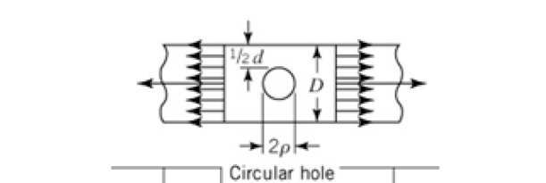
Parameter Generation
Student ID Digit # | 3 | 4 | 5 | 6 | 7 | 8
Variable | - | - | Shape | t/ρ | ρ/d | ρ (mm)
Actual ID Digit | 2 | 7 | 4 | 0 | 9 | 6
Table 1: Variable seed values
Shape
t/ρ | unused
ρ/d | 0.90
ρ | 6 mm
L | 200 mm
δ_{axial} | 0.02 mm
Table 2: Generated plate parameters

Slide 4
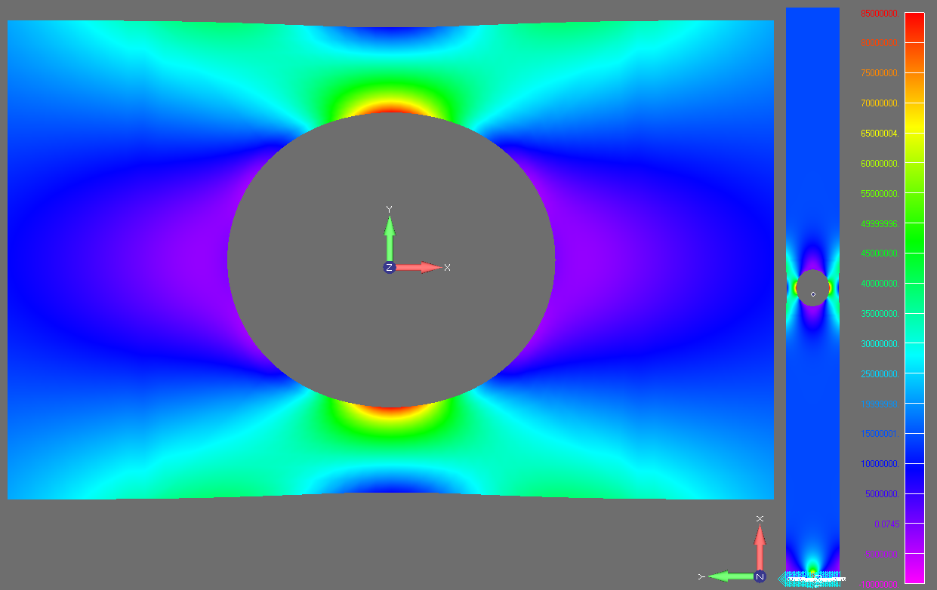
FEA Stress Contour Plot
Figure 1: Plate Bot X Normal Stress contour plot, full and zoomed views, Scale %: 1

Slide 5
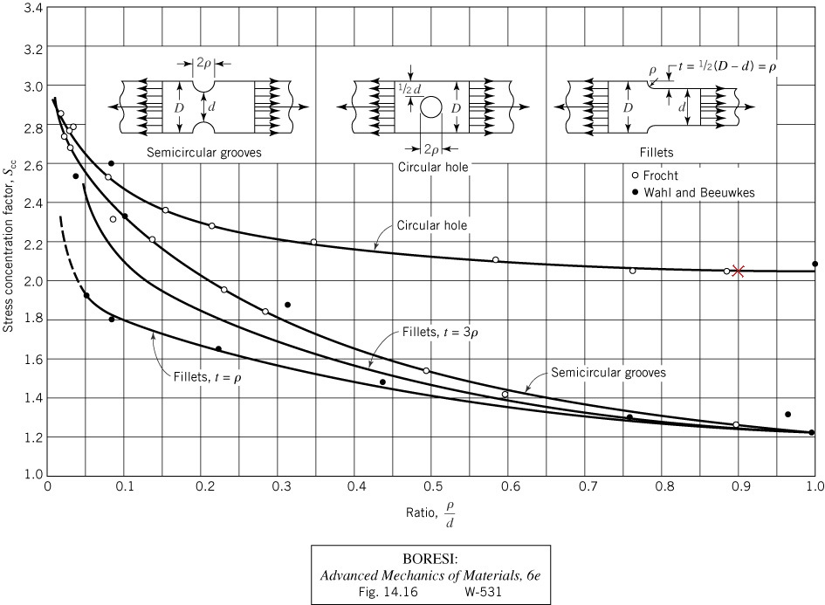
Stress Concentration Figure
2.051±0.005
Figure 2: Stress concentration factors derived from empirical photoelastic data

Slide 6
Discussion
 | FEA | Figure 2 | % Difference
S_{cc} | 2.053 | 2.051 | 0.06%
Table 3: FEA and Fig. 2 results comparison
There is excellent agreement between S_{cc} values found from Fig. 2 and values derived from FEA model, 0.06% difference.
Errors in FEA value due to interpolation, extrapolation, and averaging of elemental stress values to find nodal stress on free edge. Limitations in spatial resolution available because of finite size elements.
Errors in Fig. 2 value because best fit line through empirical data not exact.
Measurement error associated with interpreting anti-aliased pixels of Fig. 2 curve and axis tick marks.

Slide 7
Conclusion
FEA model and graph of empirically derived photoelastic data used to calculate stress concentration factor.
Value of ~2.05 found for S_{cc}
Excellent agreement between two values, 0.06%

Slide 8
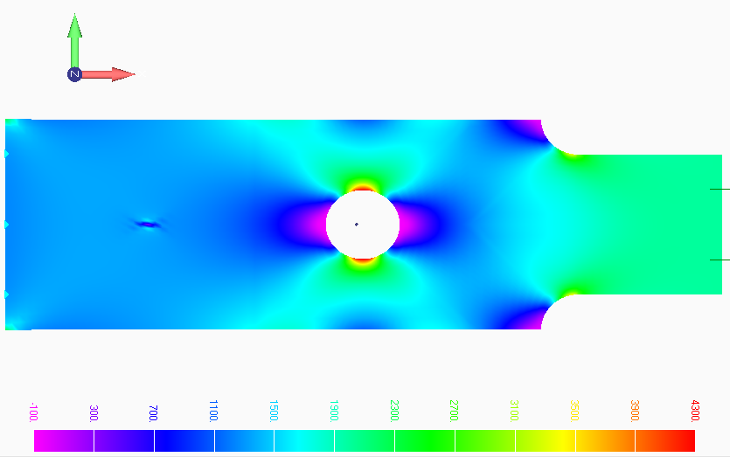
Appendix A – Femap Tutorial

Slide 9
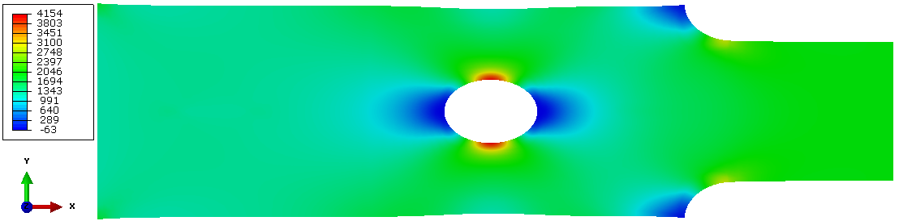
Abaqus CAE Tutorial

Slide 10
Appendix B - Interpolated FEA Data

